Slide 1
Motivation
Oxford University
Software Engineering Programme
January 2018

Slide 2
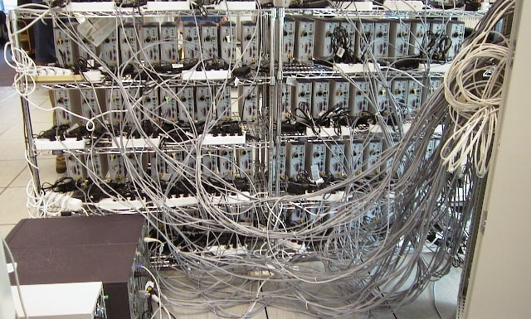
Distributed Computing

Slide 3
Why is Distributed Computing important?
Scale
Evolution
Integration
Cross-boundary
Resilience

Slide 4
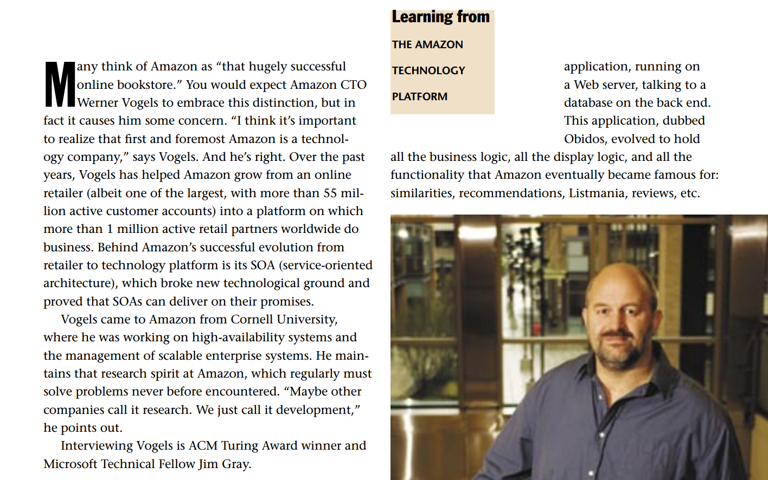
Source: Interview with Werner Vogels, ACM Queue
https://queue.acm.org/detail.cfm?id=1142065

Slide 5
“Obidos”
Web App
Database
Web App
Web App
Single application

Slide 6

But it was Successful!

Slide 7
Internet Scale Up
Web App
Database
Web App
Web App
Single application

Slide 8
… to bursting point
Database
Web App
Web App
Web App
Web App
Web App
Web App
Web App
Web App
Web App
Web App
Web App
Web App
Web App
Web App
Web App
Single application

Slide 9
Problems
Too many complex pieces of software in a single system
No evolution possible
Need to scale independently
Parts sharing resources with other unknown code paths
No isolation
No clear ownership

Slide 10
Database scaling
Databases a shared resource
Hard to scale-out
Front-end and backend shared by
Too many teams
Too many processes

Slide 11
A new model
In 2001 decided on a new approach
SOA based – even before the term was in common usage
Encapsulating the data with the business logic that operates on the data
Only access through a published service interface
No direct database access is allowed from outside the service
No data sharing among the services.

Slide 12
Growth
Amazon services in the hundreds
A typical visit to the homepage may include calls to 100 services
Caching reduces the actual network traffic
Fully distributed, decentralized
The web servers are just one client into the service fabric

Slide 13
Matched by business growth
Amazon is supporting many new businesses
Books, CDs, Electronics, Toys, Tools and Hardware,…
Plus millions of independent retailers sharing the Amazon platform

Slide 14
Lessons learnt
Isolation
Service Orientation promotes ownership and control
Scalability
By preventing direct database access, can scale the services without affecting clients
Need a common service-access mechanism
Aggregation
Routing
Tracking

Slide 15
Organization
“Each service has a team associated with it, and that team is completely responsible for the service—from scoping out the functionality, to architecting it, to building it, and operating it… You build it, you run it” Werner Vogels, CTO, Amazon
Promotes Customer Focus and Innovation
Gives developers direct access to customers
And experience of how their code performs

Slide 16
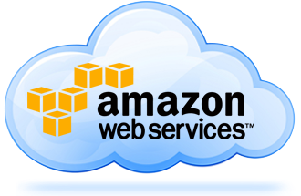

Slide 17
Why did SOA evolve?
Directly came out of XML
Understanding the schema and structure of messages
Especially within the “fabric” not just at the endpoints
What’s different?
Metadata and third-party usage
Policies, Governance, etc
Inherent Security

Slide 18

Service
http://www.flickr.com/photos/yjv/

Slide 19
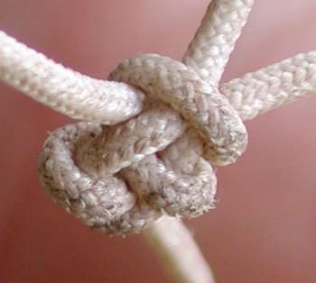
Tightly coupled
Tightly coupled systems have significant problems:
Errors, delays and downtime spread through the system
The resilience of the whole system is based on the weakest part
Cost of upgrading or migrating spreads
Hard to evaluate the useful parts from the dead weight

Slide 20
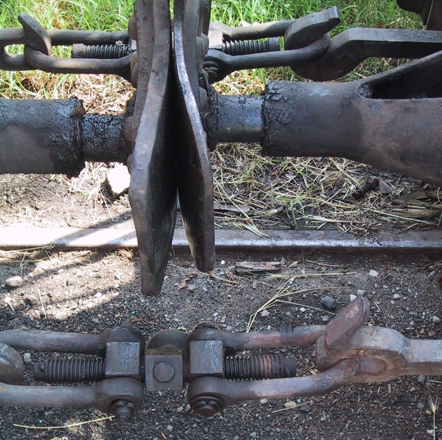
Loose coupling

Slide 21
Event Driven Architecture
Event Consumer
Event Producer
Event
Event Consumer

Slide 22
“Event Driven Architecture”
Actually how Apache (and WSO2) work(s)
Mailing lists = topics
Can be layered with reliable delivery
Used a lot in high-volume logging, trading environments, fraud detection, etc
Requires a very different mindset

Slide 23
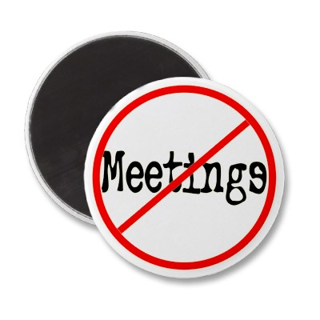
EDA

Slide 24
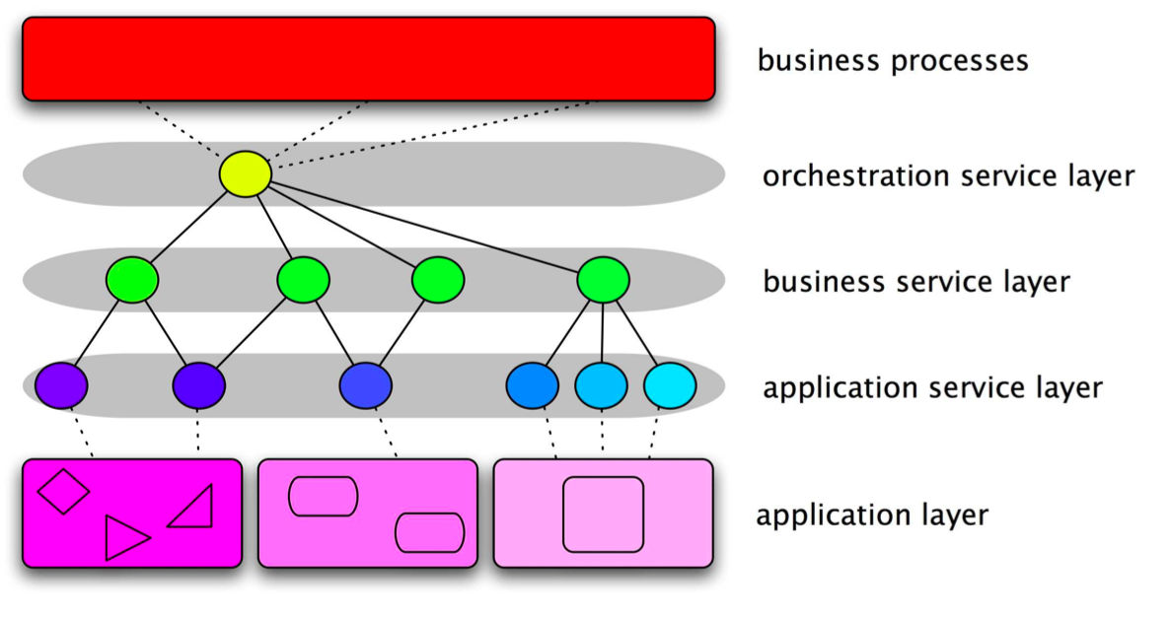
SOA

Slide 25
Micro and Macro Services
API Facade
API Facade
API Facade

Slide 26

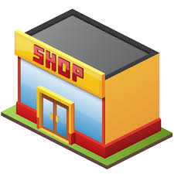




End-to-End Architecture and Functional Requirements for a Connected Business
Develop
Publish
Consume and Run
Secure
Monitor and
Manage
Systems
Of Engmnt
Web App
Development
Public / Private
App Store
Mobile Apps
Web Apps
Portal
SSO
Device Management
Web Access Mgt
API
SDKs
API Store
API Gateway
API Analytics
MBaaS
OAuth2
Service Tooling
Governance Registry
Enterprise API Gateway
Service
Access Control
Business
Analytics Monitor
SOA
Orchestration
Workflow
RT Stream Proc
ESB
Data
Virt
Taxonomy
Ontology
Data Tooling
Data Registry and Governance
Data Services
Data Access Control
Data Analytics
Big Data
Enterprise Cache
Adapter Layer
System
Of Record
Legacy Tooling
Traditional Documentation
SAP
MF
P’Soft
Legacy
Directory
Enterprise
Monitoring
Oracle
CICS
IBM
CRM

Slide 27
Web Services != SOA
There are SOA’s that don’t use Web Services
We will see some in the case studies…
There are systems that use Web Services that are not Service Oriented
e.g. Taking an existing text/TCP model and tunnelling over SOAP

Slide 28
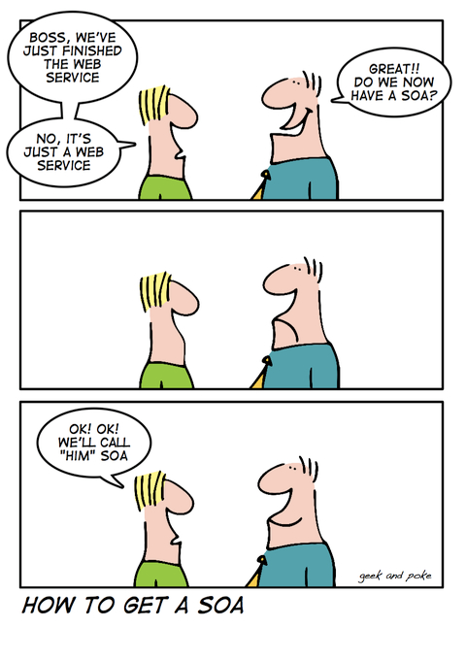

Slide 29

Business to Government

Slide 30
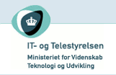
OIO SOI

Slide 31
OIO SOI
Danish Government wanted to simplify electronic business
Especially for Business-to-Government (B2G)
Potential savings of 630m Euros by digitalizing business
Requirements
Reliable delivery
Secure – encrypted and signed messages
Support small businesses

Slide 32
OIO SOI
Several aspects
A registry for service lookup
A profile of transport protocols
Open Source toolkits for Java and .NET
A reference implementation of a message handler
A legal framework
Some existing framework
A nationwide digital certificate framework
A standard XML syntax for invoices and orders (UBL2)

Slide 33
Logical architecture
This is logically a complete peer-to-peer architecture
With only a central registry
Any company can talk to any other company
Even those with only mail accounts
Cannot track all the requests!

Slide 34
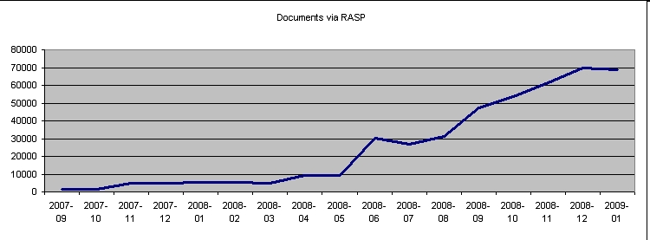
Results
18,500 companies sending invoices via RASP
Mandatory to send invoices to all government agencies
Scanning companies and a web gateway allow bridging

Slide 35
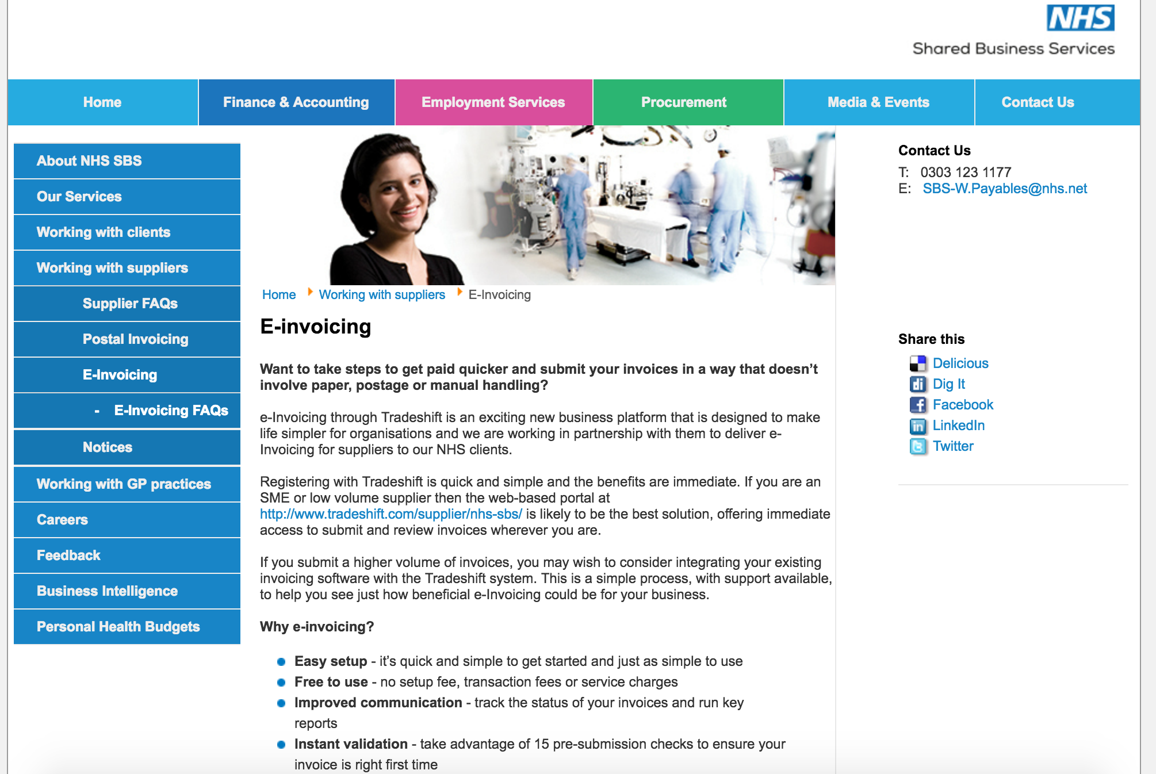

Slide 36
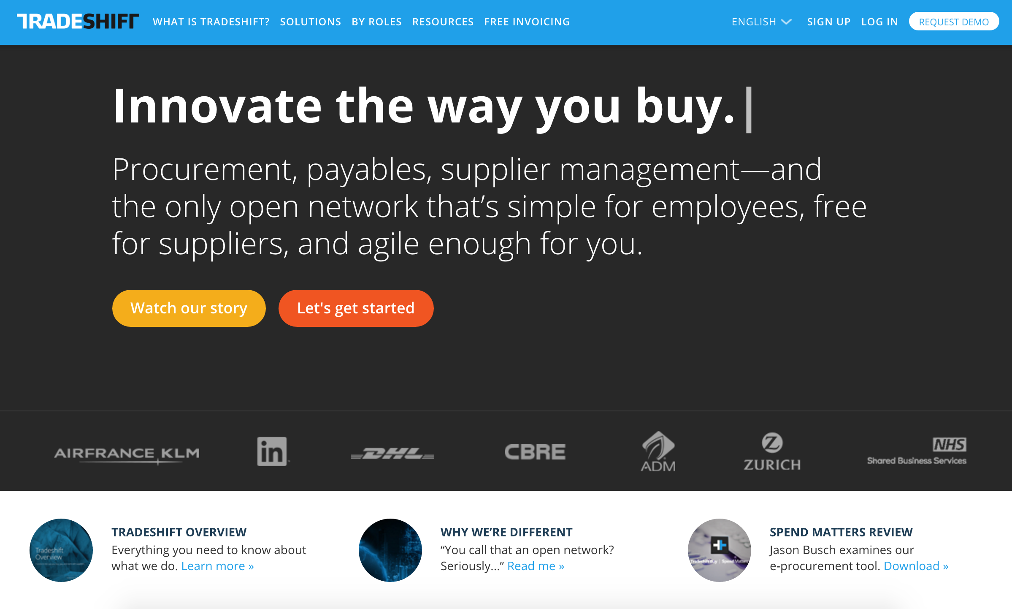
June 2016: Tradeshift raise $75m

Slide 37
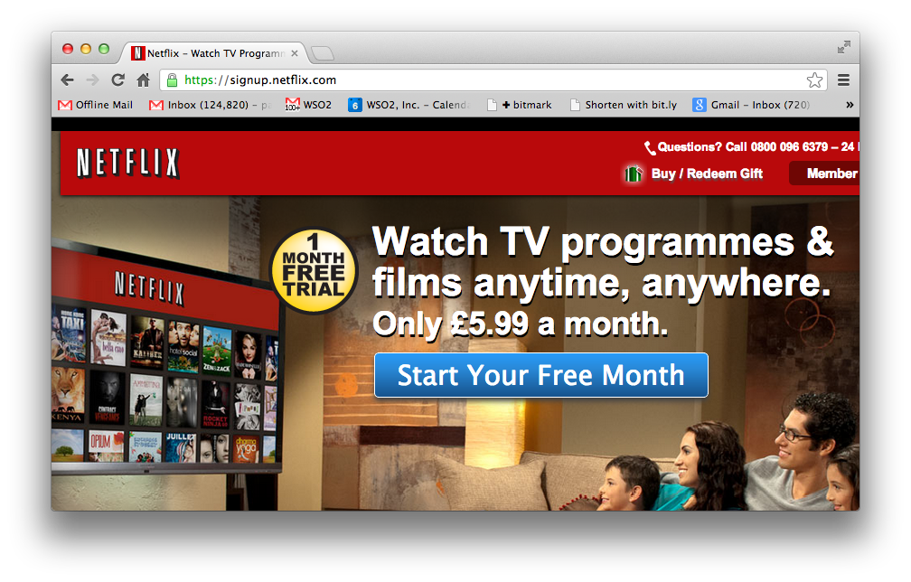

Slide 38
Netflix
A REST and Cloud based SOA approach
Continuous Delivery
100% Based in the cloud
See excellent presentations from Adrian Cockcroft
e.g. http://www.slideshare.net/adrianco/global-netflix-platform

Slide 39
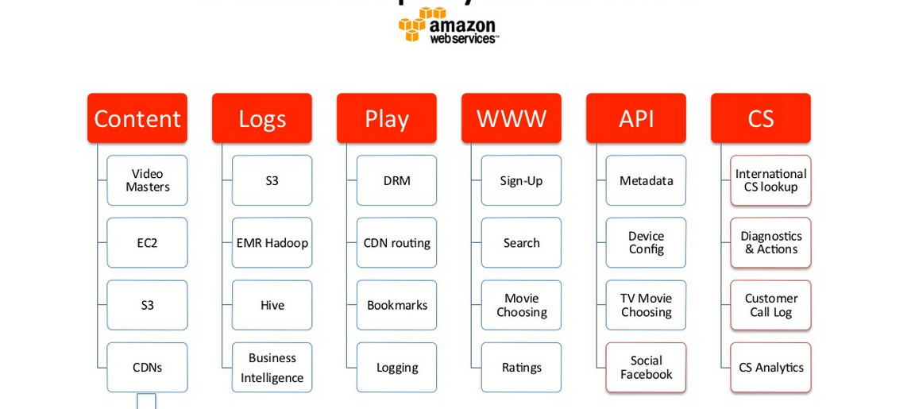
Netflix Deployed on AWS

Slide 40
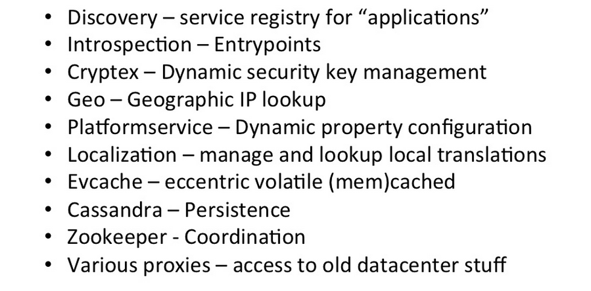
Platform Services

Slide 41
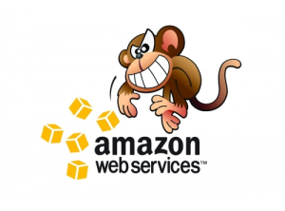
The (in)famous Chaos Monkey
Randomly kills machines
Yes, production systems
Proves that the system is resilient

Slide 42
Twitter Architecture
Open Sourced their technology:
Finagle
http://twitter.github.io/finagle/
Called an RPC system, but completely asynchronous
Based on “Services”

Slide 43
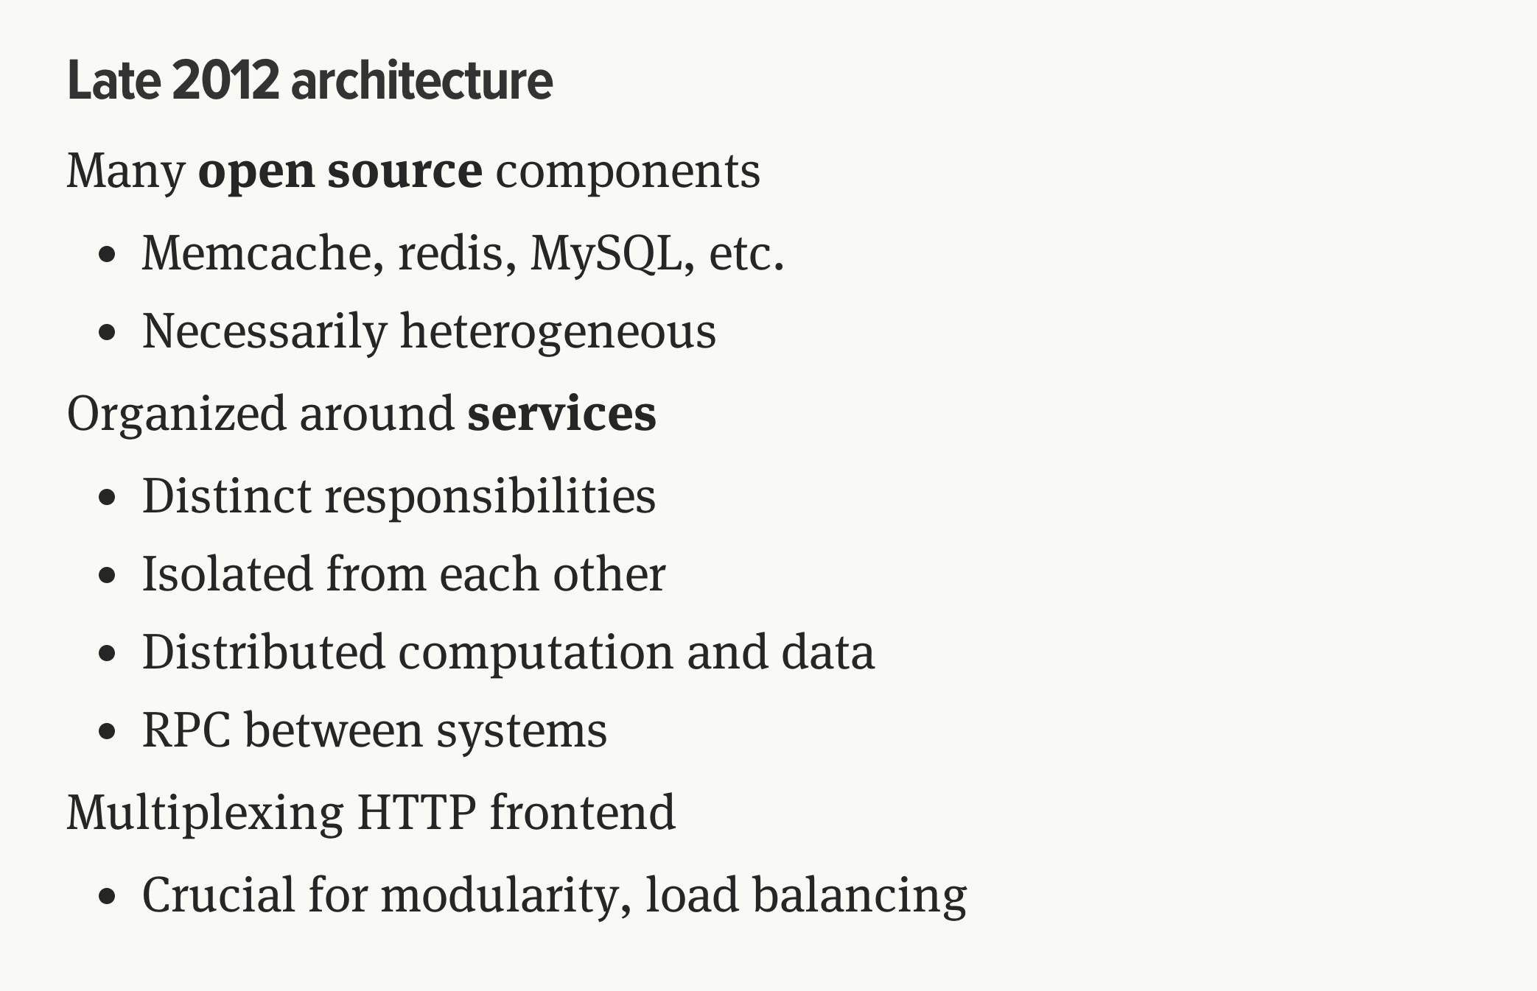
http://monkey.org/~marius/talks/twittersystems/#4

Slide 44

Boeing Digital Airline

Slide 45
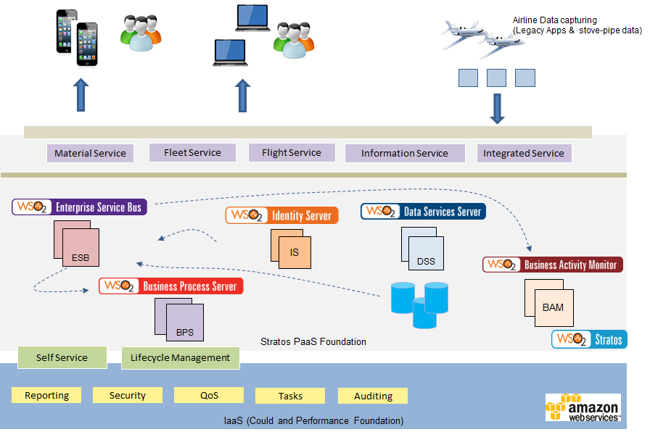
Case Study : Boeing - A PaaS based Integration and API ecosystem
Notes:
Keywords Cloud, API Integration, Billing and Monetization, Governance
Solution Targets to cater for 13,000 Boeing airplanes in Service at 900 airlines
A solution that can scale for 90 million transactions per month (as an end state)
PaaS solution to integrate airlines and OEM data
Reusable app services
Open architecture and modular design

Slide 46
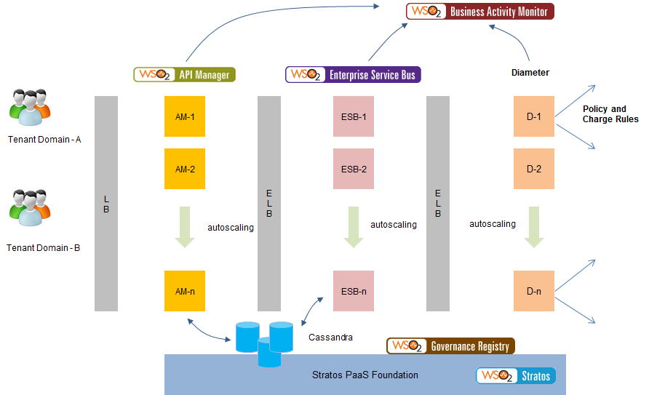
Case Study : Multi-tenanted Mobile Orchestration Gateway Platform
Notes:
Keywords Cloud, API Management, Statistics and Monetization, Openstack
Solution 40,000 transactions per second
Support for 99.999% service availability
Support for autoscalling based on Stratos2 implemented on top of Openstack
Tenant based access control for enterprises.
Unified enterprise onboarding
Licensing integration, statistics and monertization

Slide 47
Pay TV company
Needed to scale up to provide instant pay-as-you-go on mobile devices
Support Disaster Recovery (DR)
Elastic Scale e.g. during an important football match

Slide 48
Architecture
Clients
Clients
Clients
Existing architecture
(no changes)
RESTful Services
Notification
Integration Layer
Replication
Cloud/NoSQL Multi-Master Database
Cloud Platform
Cloud Datacenter

Slide 49
Anti-patterns
Use a full waterfall model
Don’t budget time for integration test
Assume that standard coding unit test->integration test will work
Build unit tests that don’t test interoperability
E.g. Simulate XML request/response inside the calling system rather than calling a remote system
Wait until all the systems are ready before starting any integration test
A delay to one system will hold up testing all the others
Don’t bother with continuous build and test
Even better build by hand
Even better test by hand too
Have a nice complex process to hand over from development to test
That way each defect will take a long time
Wait until the project is failing to find out your team doesn’t have the skills

Slide 50
Questions?

